Slide 1
Chapter 1
The Context of Systems Analysis
and Design Methods

Slide 2
Definitions
System
  is a group of interrelated components that function together to achieve a desired result
Information System
  arrangement of people, data, processes, presentation, and information technology
Information Technology
  hardware and software combined with data, image, and voice networks

Slide 3
Definitions
Data
  raw facts about the organization and its business transactions with little meaning and use by themselves and is a byproduct of business
Information
  data that has been processed and reorganized by into a more meaningful form and is a resource to business
Knowledge
  data and information that is further refined based on judgements and experience

Slide 4
Stakeholders
Owners
Users or Clients
Designers
Builders
System Analysts
External Service Providers
… are all information workers

Slide 5
Types of Information Systems
A transaction processing system (TPS) is an information system that captures and processes data about business transactions.
A management information system (MIS) is an information system that provides for management-oriented reporting based on transaction processing and operations of the organization.
A decision support system (DSS) is an information system that either helps to identify decision making opportunities or provides information to help make decisions.

Slide 6
cont’d
An expert system is an information system that captures the expertise of workers and then simulates that expertise to the benefit of non-experts.
A communications and collaboration system is an information system that enables more effective communications between workers, partners, customers, and suppliers to enhance their ability to collaborate.
An office automation system is an information system that supports the wide range of business office activities that provide for improved work flow between workers.

Slide 7
System Owners
Project sponsors or chief advocates of the information system
Responsible for funding the development, operation, and maintenance of the information system

Slide 8
System Users or Clients
Internal Users
  Clerical and service workers
  Supervisors and managers
  Technical and professional staff
      (also known as knowledge workers)
Remote and Mobile Users
  Geographically separated from the business
External Users
  Customers and suppliers

Slide 9
System Designers
Translate the business requirements into technical solutions
Design the databases, inputs, outputs, screens, networks and programs that will meet the system requirements

Slide 10
System Builders
Construct the information system components based on design specifications generated by the system designers
Some examples are applications programmers, database developers, network administrators, and webmasters

Slide 11
System Analysts
Facilitate the development of information systems and computer applications by …
Studying business problems, recommending improvements, and specifying requirements known as system analysis
Specifying or constructing computer-based solutions for the requirements, known as system design
… they are problem solvers

Slide 12
Skills needed by a Systems Analyst
Systems analysis and design skills
Working knowledge of IT
Computer programming experience
General business knowledge
Problem-solving skills
Interpersonal communication skills
Interpersonal relations skills
Flexibility and adaptability
Character and ethics

Slide 13
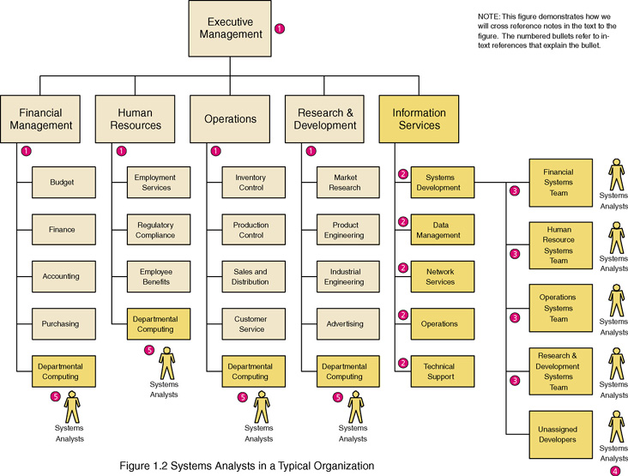
Where System Analysts Work

Slide 14
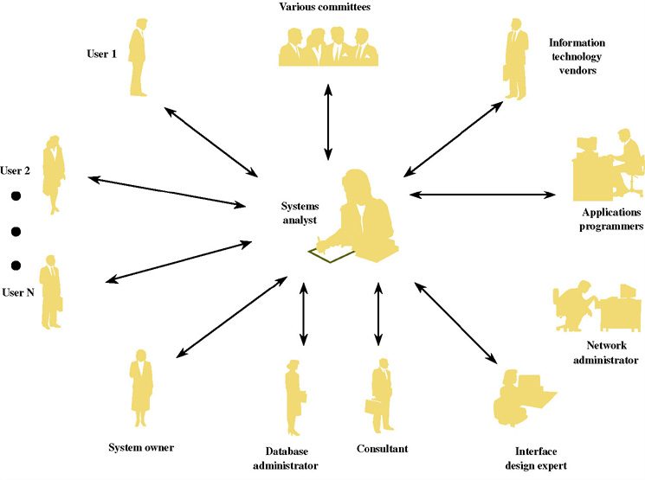
The System Analyst as a Facilitator

Slide 15
External Service Providers
provide specialized knowledge or skills
are an external resource to supplement the need for additional personnel
Outsourcing is contracting with a vendor to assume responsibility for an on-going service
Consulting is contracting with a vendor to assume responsibility for or participate in a specific project

Slide 16
Business Trends
Globalization of the Economy
Electronic Commerce
Security and Privacy
Collaboration & Partnership
Knowledge Asset Management
Quality Management
Business Process Redesign

Slide 17
Technology
Networks
Internet
Mobile and Wireless Technologies
Object Technologies
Collaborative Technologies
Enterprise Applications

Slide 18
Possible Scenarios
Problem
  a real or anticipated situation that requires corrective action
Opportunity
  to improve a situation despite the absence of complaints
Directive
  to change a situation regardless of whether anyone has complained

Slide 19
System Development Process
Identify the problem
Analyze and understand the problem
Analyze and identify requirements
Analyze and identify alternative solutions and select the best one
Design the chosen solution
Implement the solution
Evaluate the results and make improvements

Slide 20
System Development Phases
Initiation
Analysis
Design
Implementation
Continuous improvement and support

